Slide 1
Competitiveness and Diversification Along Key Export Corridors and Investment Climate for Value Chain Development Donald Mmari KNOWLEDGE SHARING ON TRADE AND INVESTMENT “GOOD PRACTICES”, ACP House, Brussels, Belgium 21st February 2018

Slide 2
Outline
Introduction
Policy Landscape
Outputs of Programme of Support
Good Practice Cases
Key constraints to competitiveness
Limits of TA Support
Way Forward

Slide 3
Introduction
Tanzania is an emerging economy experiencing long term growth rates of over 6% per annum since 2005.
Tanzania is an attractive trade and investment destination by virtue of:
political stability,
advantageous geographical location with a 1,424 km long coastline and 8 neighbours,
youthful and growing population, est. 51.5 million in 2017,
membership to regional trading blocks, EAC and SADC.
AGOA, EPA
Main export corridors: Southern, Western, Central, Northern and Zanzibar-Pemba
Notes:
Southern Export Corridor — A largely agricultural corridor focusing on cereals, agroforestry, tea, coffee, pulses and horticulture. Coordinated by among others the Southern Agricultural Growth Corridor of Tanzania (SAGCOT), a Public Private Partnership (PPP) focusing on agriculture and infrastructure. The corridor links the port of Dar es Salaam and other areas in Tanzania with the countries Southern neighbours including Mozambique, Zambia and Malawi. Also used as transit for exports of Zambian Copper.
(ii) Western Export Corridor— Dominated by tobacco, pyrethrum, coffee, cotton, fisheries, agroforestry and minerals. Mainly serves the DR. Congo, Rwanda, Uganda and Burundi
(iii) Central Export Corridor— a logistic hub due to its road and rail network linking other export corridors with the main port of Dar es Salaam. Has limited agriculture potential—nuts, some cereals and grapes— due to its semi-arid climate. Serves similar countries to Western Corridor. Coordinated by the Central Corridor Transit Transport Facilitation Agency (CCTFA)
(iv) Northern Export Corridor—Coffee, tea, horti and floriculture. Links rest of Tanzania to Kenya. Has direct access to the international airport in Kilimanjaro and the Kenyan port of Mombasa
(v) Zanzibar-Pemba Export Corridor—Spices (including cloves) and seaweed. Has potential to expand to natural gas and/oil. Has direct access to the Indian Ocean and close proximity with the international airports in Zanzibar and Unguja.

Slide 4
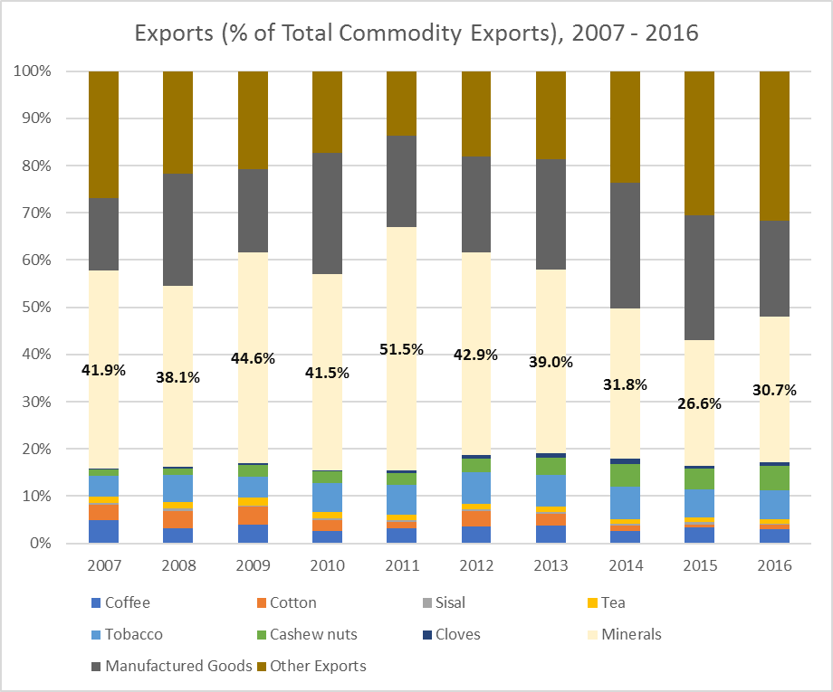
Introduction-2
Non-traditional exports growing, includes horticultural
Traditional exports stagnant, except cashew and tobacco

Slide 5
Introduction-3
Trade
Exports grew from € 750 million in 2010 to € 1,958 million in 2016.
Imports grew from € 4,032 million in 2010 to € 6,155 million in 2016.
Yet to ratify a regional Economic Partnership Agreement (EPA) with the EU
Competitiveness
Ranks poorly in the bottom quintile of WEF’s Global Competitiveness Index at 116th out of 138 countries
Ranks 139th out of 189 economies in World Bank’s 2016 Doing Business report.
Investment
Net FDI flows have slowed to 2.9% of GDP (€1,102 million) in 2016 from 5.8% (€ 1,464 million) in 2010 (World Bank, 2017).
Notes:
Tanzania’s export potential hampered by supply side constraints including: Inadequately coordinated trade and investment policies, poor and unreliable infrastructure, weak education and training, limited access and absorption of technology. These undermine the realisation of recent gains in labour market efficiency, institutional and macroeconomic environment to improve the competitiveness of productive sectors, including agriculture.

Slide 6
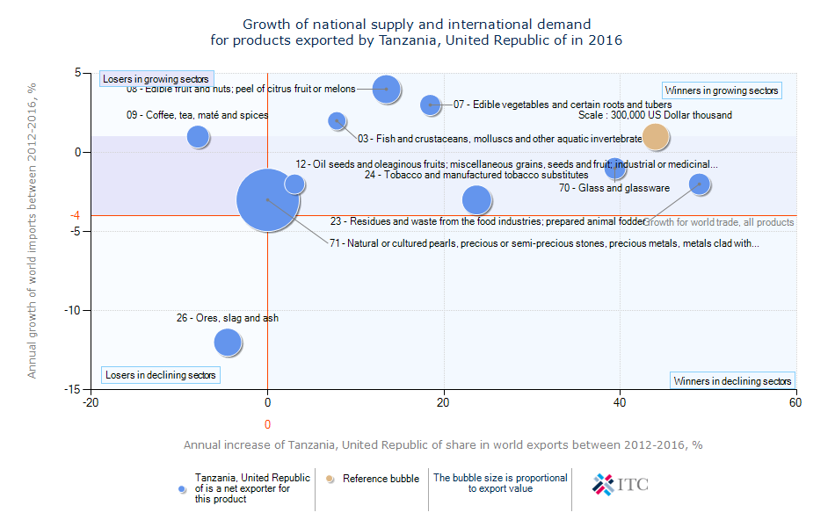

Slide 7
Outputs of Programme of support
Current Programme: P006: Targeted Support to REPOA and Zanzibar Ministry of Trade, Industry and Marketing to Increase the Competitiveness of Primary Producers and Diversify the Export Base in light of the Trading Opportunities with the EU
TA has two main purposes:
Purpose 1: To identify bottlenecks that limits competitiveness and export diversification in agriculture and the trade policy framework to effectively address them;
Purpose 2: To strengthen REPOA’s and subsequently Tanzania’s research and advisory capacity on trade policy, competitiveness and elimination of NTBs to enhance country’s trading capacity with the EU and beyond.

Slide 8
Policy Landscape
Current trade (2003 for Mainland, 2006 for Zanzibar) and investment policies (1996 for Mainland, 2004 for Zanzibar) are outdated to effectively promote competitiveness and diversification-quality matters, innovation is rapid, customization
BUT policy revision underway: see WB’s 2017 DTIS and Zanzibar’s draft (but binned) 2016 policy. DTIS focuses on: agriculture, mining and extractives and tourism
Trade and investment priorities are outlined in FYDP II with industrialization as its main agenda
FYDP II supports value-addition and beneficiation towards improving agricultural productivity and deepening agricultural value chain
Notes:
In contrast to past trade and investment blueprints, the DTIS discusses concerns on Sanitary and Phytosanitary (SPS), Technical Barrier to Trade (TBT) as well as regulatory and other institutional bottlenecks hindering trade and investment in Mainland Tanzania and Zanzibar

Slide 9
Good Practice Cases
Zanzibar Exotic Originals Label
Launched in 2015 involving the International Trade Centre (ITC), World Intellectual Property Organization (WIPO) and Zanzibar’s State Trading Corporation (ZSTC)
A sectoral brand strategy for spices
Features premium branded packaging and promotional materials-islands’ history, spice story, tourism experience and investment potential
Branded spices in tourist market- cloves, chilies, cinnamon and other organic spices
Three-year pilot agreement in 2017 with GANEFRYD of Denmark, to export branded organic cloves and selected spices to Europe.
Notes:
Farmers and small businesses generally earn less than ten per cent of the final price of primary goods, as the largest margins are captured by importers and retailers. Differentiating products through branding allows the balance to shift in favour of growers and small businesses to capture more value. By contrast, selling unbranded dried spices like chillies allows middlemen to mark up prices by 300-400 per cent before selling to the tourism sector. Another pillar for the branding strategy is to register a geographical indication for cloves, which involves various steps in scientific identification. The branding initiative also supports local processing and packaging using simple technologies

Slide 10
Good Practice Cases-2
AFRICADO COMPANY LTD
State-of-the-art processing, cold-chain and packaging facility in 2012 - grant from TradeMark East Africa Challenge Fund (TRAC)
Raised competitiveness of AFRICADO’s products, improve quality of produce and access to the export market
Avocado exports from 488,492 kgs (122,123 4kg cartons) in 2012 to 2,579,976 kgs (644,994 4kg cartons) in 2016, a 428.48% increase
The first Tanzanian company exporting avocados to the UK-Ocado, Sainsbury, Tesco and Waitrose supermarkets

Slide 11
Lessons from the two cases
Targeted support towards branding pays off, & farmers get more for their produce
Investment in meeting quality standards, while expensive, helps to secure markets and stimulate export
Sector specific policy reforms and PPP important
Sustained efforts to enhance business environment and political stability attracts export oriented FDI
Technology driven agriculture transformation is the way for the future– but entry costs for small producers entails strategic value chain partnership

Slide 12
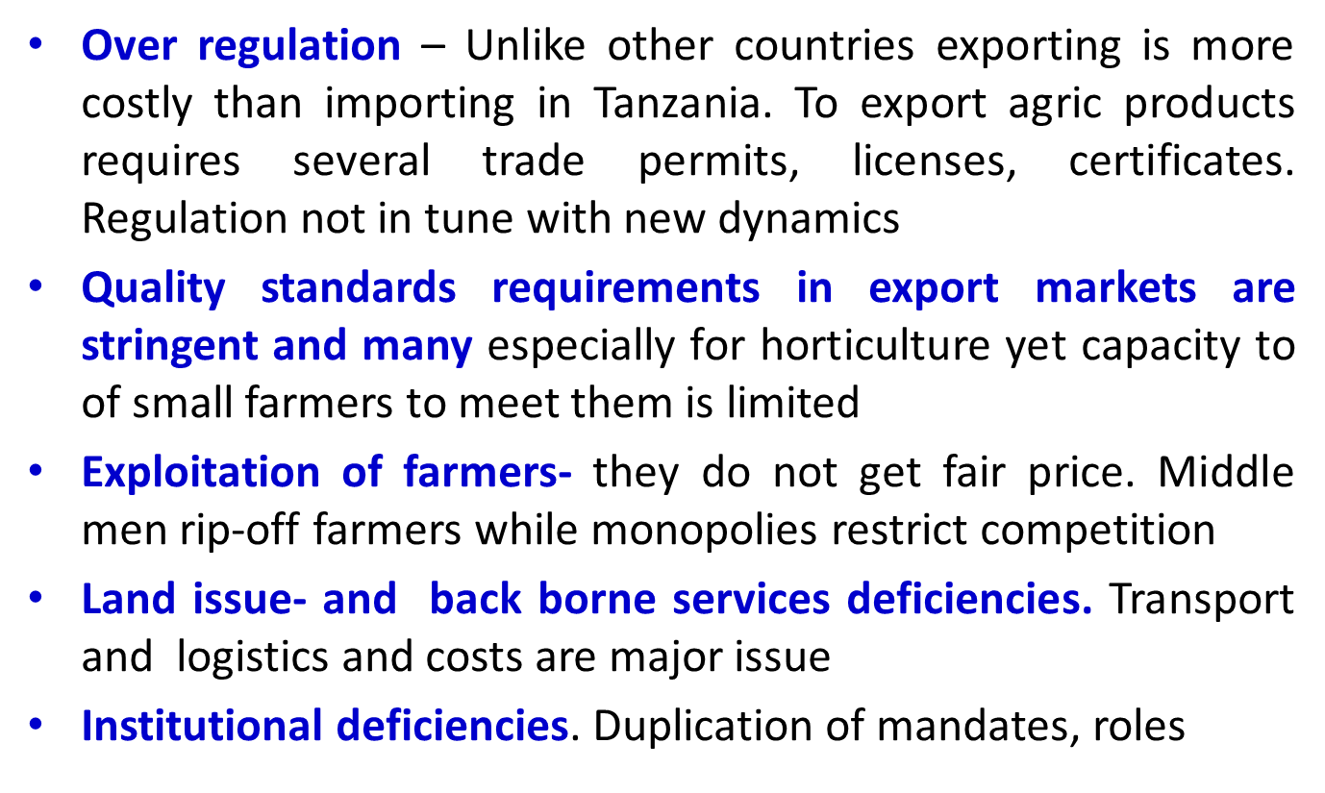
Key constraints to competitiveness

Slide 13
Limits of TA Support
Short-termism: TA has not facilitated continued dialogue among Trade Support Institutions (TSIs) necessary for sustainable solutions to competitiveness and diversification bottlenecks.
Lack of guidance in accessing implementation funds: TA’s recommendations require substantial investment in TSIs and other value chain actors NOT financially supported by TA.
Medium to long-term sustainability of TA at risk as not much learning has occurred between TSIs and other value chain actors. TA prioritised research capacities of beneficiaries while eschewing knowledge and skill transfer to producers and processors

Slide 14
Way Forward
Additional support to REPOA and other TSIs to play a prominent role in revision of Tanzania’s trade policy to foster the competitiveness of agro-exports, diversification and value chain development. This would improve policy impact of TA
Further TA needed to institute a long-term research programme on trade policy and regional integration, building on present TA to address long-standing concerns on agri-trade research—data inconsistencies, M&E systems
Sustainable capacity building needed to build a critical mass of policy analysts, researchers and trade negotiators in Tanzania

Slide 15
Thank You for Your Attention!

